Slide 1
Software Architecture -
Nonfunctional Requirements (NFRs)
Phil Pfeiffer
February 2013
Key Source: Barrett course notes, CSCI 5300, spring 2010

Slide 2
Functional Requirements (FRs) vs. NFRs
FRs specify outputs as function of inputs
NFRs specify how system must run
▪ may not be directly observable
▪ may not be tied to any given input or output
▪ may
▪ define overall system attributes
▪ constrain implementation
▪ specify resources or timing
▪ are difficult to
▪ elicit - average users don't know what to say
▪ specify - "X transactions/sec." for X = ??
▪ prioritize - e.g., balancing response, throughput

Slide 3
Meta-Requirements for NFRs
specific, non-ambiguous
measurable
technically feasible
realistic with respect to resources
traceable

Slide 4
Rationalizing NFRs: Softgoals
Softgoal: imprecise NFR - e.g.,
▪ "bank accounts must be secure"
Refine to more specific categories - e.g.,
▪ account confidentiality, integrity, availability, appropriate use
Continue to specific, measurable statements
▪ "user must authenticate via ID and PIN"
Lawrence Chung, Brian Nixon, Eric Yu, Non-Functional Requirements in Software Engineering

Slide 5

Categorizing NFRs: Moody and Barrett
Chung et. al.'s "big three"
▪ performance (in time and space)
▪ hardware: mean performance, response time, throughput …
▪ software: mean performance, response time, throughput …
▪ cost (w.r.t deployment)
▪ before: development, domain analysis, planning, tracking…
▪ thereafter: operation, maintenance, reengineering, retirement…
▪ security
▪ malicious outsiders
▪ flawed modules

Slide 6
Categorizing NFRs: Moody and Barrett
Chung et. al.: eight more categories
end user: objective (e.g., availability),
subjective (e.g., customer loyalty)
future: access, maintenance, change, operation
(system) integrity: security, error management
intersystem interaction: accessibility, compatibility…
SRS: quality, content of SRS
testing: test environment, test system
time: pre-deployment, post-deployment
user interface: learnability, ease of continued use
Moody, James, Categorizing non-functional requirements using a hierarchy in UML, 2003;
http://etd-submit.etsu.edu/etd/theses/available/etd-0330103-170022/unrestricted/MoodyJ04292003b.pdf (last accessed 20 February 2011)

Slide 7
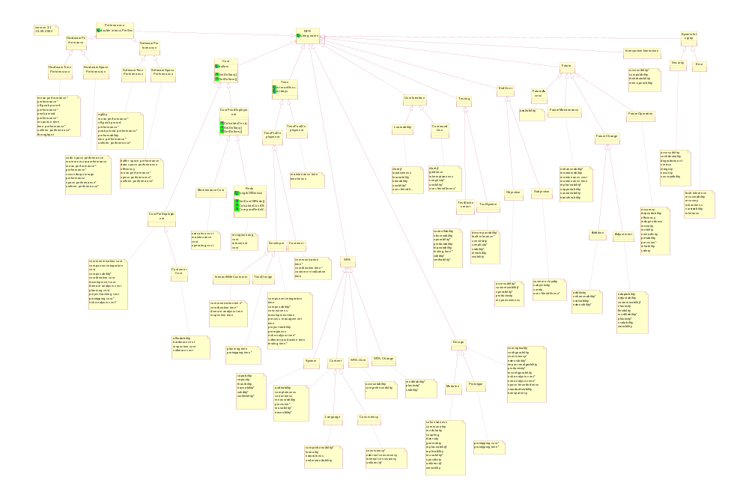
Moody/ Barrett NFR Tree

Slide 8
Pragmatics: Process NFRs
Delivery
▪ when, what, partial deliveries
▪ compliance / noncompliance
Implementation
▪ use of languages, tools
▪ compliance / noncompliance
Standards
▪ community, internal
▪ compliance / noncompliance

Slide 9
Pragmatics: Product NFRs
Portability
▪ not a common concern
▪ issues: language; operating system; dependent APIs
▪ hard to quantify; characterize in terms of measures taken
Security
▪ services (access, proper use); data security; external communication
▪ hard to quantify; characterize in terms of measures taken
Usability
▪ Jakob Nielsen's usability heuristics
(cf. http://www.useit.com/papers/heuristic/heuristic_list.html)
▪ look and feel; ease of learning; ease of use; intuitiveness
▪ quantify using prototypes, testing
Maintainability
▪ quantify using documentation testing; time to install, implement typical changes, skills needed by support staff, scalability

Slide 10
Pragmatics: Product NFRs
Reliability
▪ consistent behavior in normal operating modes
▪ strategies for quantifying
▪ data integrity
▪ statistical analysis of datasets for anomalies
▪ logic integrity
▪ bug counting - "no more than X errors / Y lines of code"
▪ Monte Carlo -
▪ seeding errors, then
▪ checking regression suite's ability to identify them
▪ availability
▪ mean time to failure (MTTF)
▪ mean time to repair (MTTR)
▪ availability = MTTF / (MTTF + MTTR)

Slide 11
Weighting Reliability Issues (Barrett)
cause mild inconvenience
cause minor financial loss
cause major embarrassment
cause major financial loss
bankrupt the firm
injure
kill a few
destroy many people
destroy all humankind

Slide 12
Pragmatics: Product NFRs
Safety: related to other issues
▪ reliability: unpredictable behavior may be unsafe
▪ security: malicious damage may be unsafe
▪ performance: overload, over-committed resources may be unsafe
▪ usability: confused users may perform incorrect actions
Performance: peak, mean performance, off-peak
▪ space: conserving scarce resources (memory, disk, buffers…)
▪ capacity: #users, #terminals, #records
▪ time: response, throughput
▪ exceptional conditions
▪ quantify in terms of loss of performance, functionality under
▪ increased (excessive) load
▪ subsystem failure

Slide 13
Pragmatics: External NFRs
Legal
  ownership
  privacy
Economic
  development cost
  cost of ownership
  overruns
Interoperability
  interface with existing systems
  interface with external components

Slide 14
NFRs: Summary of Challenges
Integrating with standard design methodologies
Managing constraints that are hard or impossible to specify initially
▪ Requirements for mean time to failure
▪ Requirements for human-computer interaction
Balancing between contradictory goals
▪ Performance vs. cost
▪ Scope and cost vs. time to develop

Slide 15
NFRs: Recommendations
▪ Quantify - or, at least, state - goals
▪ Clarify NFR relationships to user goals
▪ Clarify NFR relationships to risk items
▪ Assign severity levels to risk items
▪ non-critical
▪ business critical: economic damage possible
▪ mission critical: mission cannot be done
▪ safety critical: life or environment at stake
▪ Use risk analysis techniques to identify key requirements

